Slide 1


AtliQ Retail Mart Promotion Analysis
Banuvathy R

Slide 2

Introduction
AtliQ Mart is a retail giant operating over 50 supermarkets across the southern region of India.
AtliQ Mart conducted extensive promotional campaigns during Diwali 2023 and Sankranti 2024 across all its stores.
Diwali
12 Nov 2023
Sankranti
16 Jan 2024
18 Nov 2023
10 Jan 2024

Slide 3
Project Objective
To gain a deeper understanding of how effective our promotions have been, enabling us to make informed decisions for our future promotional campaigns.

Slide 4
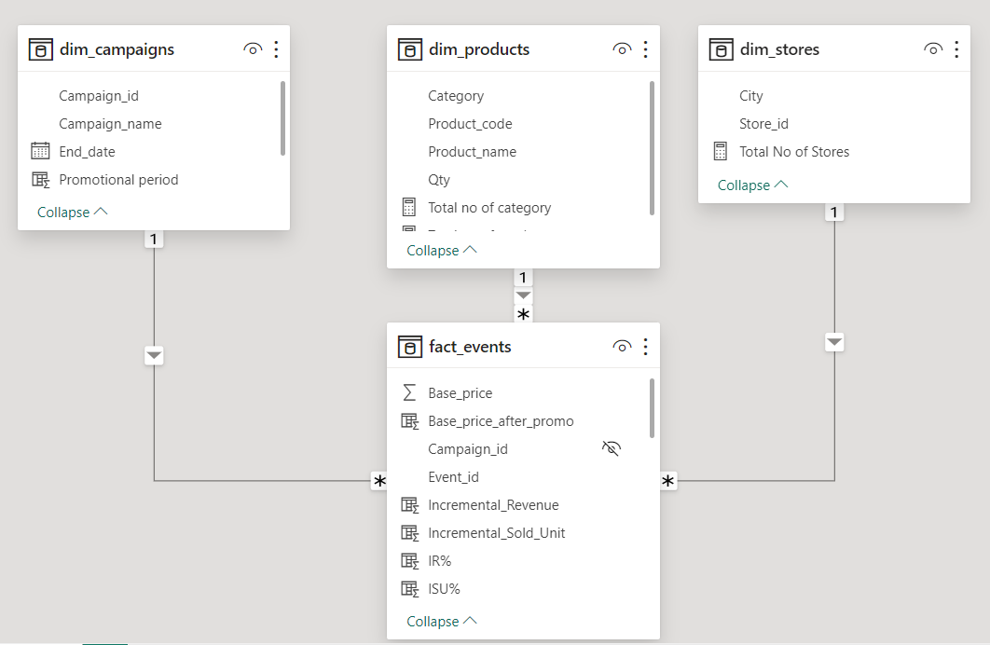
Dataset
Dataset includes 4 csv files:
1. dim_campaigns
2. dim_products
3. dim_stores
4. fact_events

Slide 5
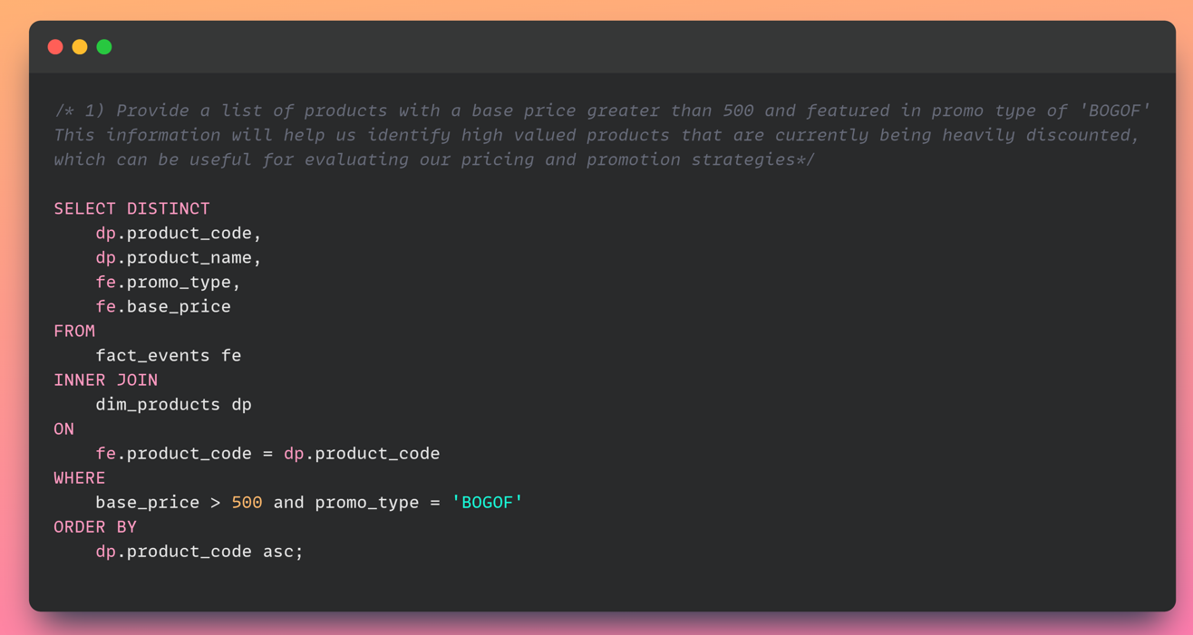
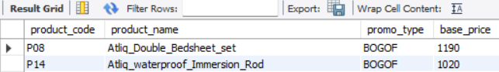
Provide a list of products with a base price greater than 500 and featured in promo type of 'BOGOF'

Slide 6
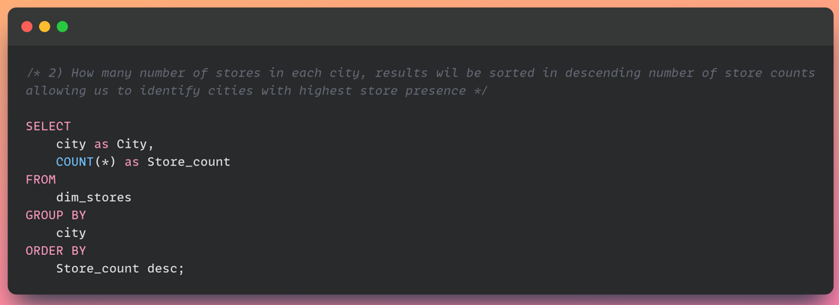
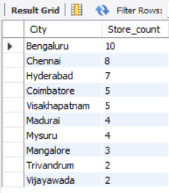
How many number of stores in each city, results will be sorted in descending number of store counts allowing us to identify cities with highest store presence?

Slide 7
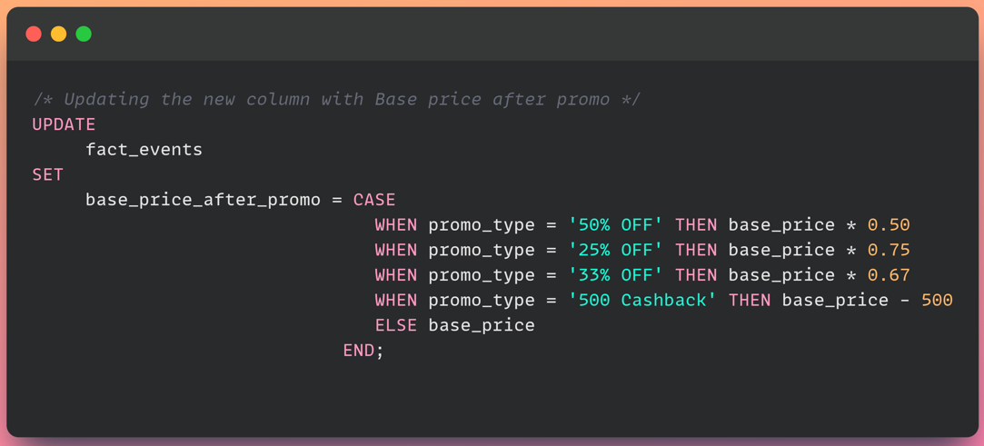
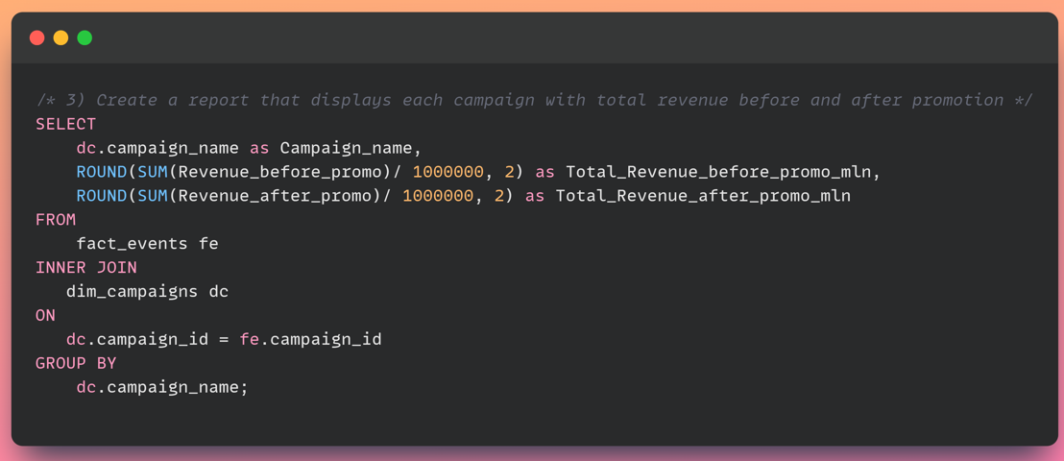
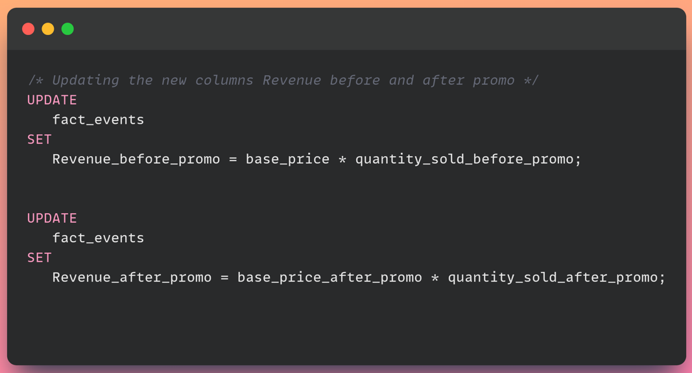
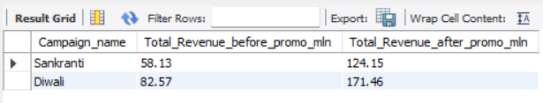
Create a report that displays each campaign with total revenue before and after promotion (expressed in millions)

Slide 8
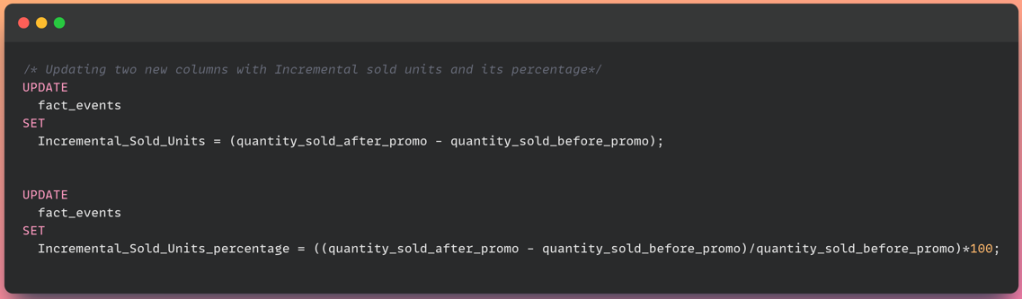
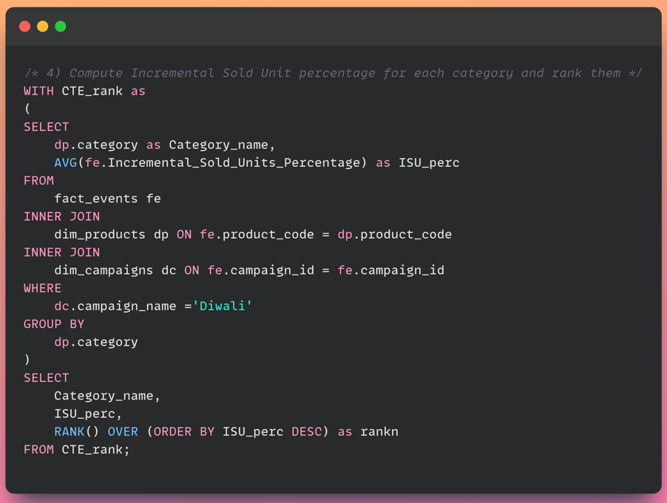
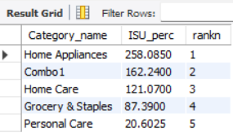
Compute Incremental Sold Unit percentage for each category and rank them

Slide 9
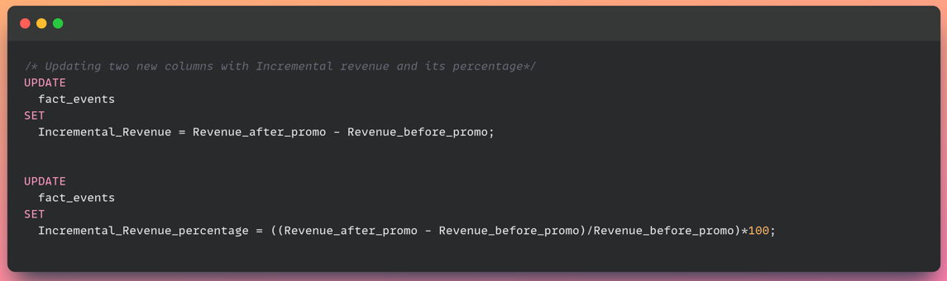
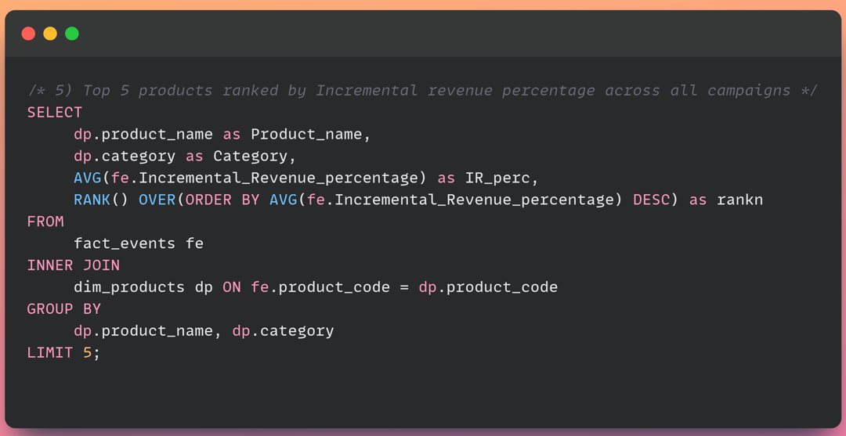
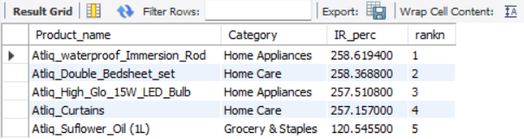
Top 5 products ranked by Incremental revenue percentage across all campaigns

Slide 10
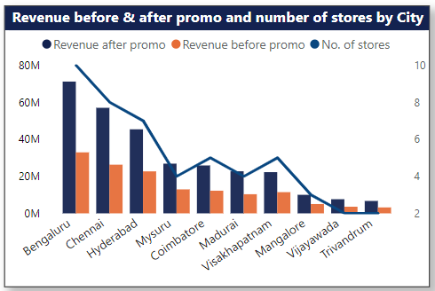
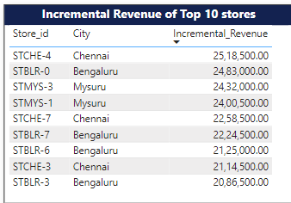

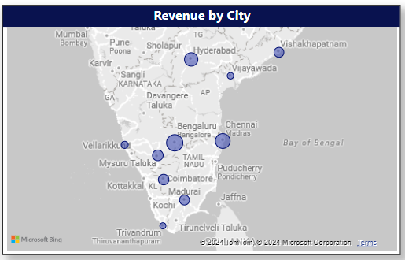
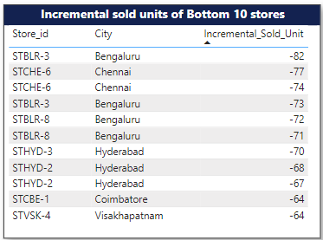

Store Analysis
Higher the number of stores in a city, greater the revenue from that city after promotions.

Slide 11
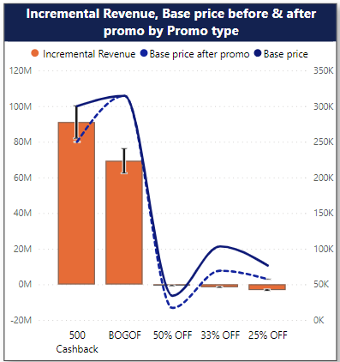
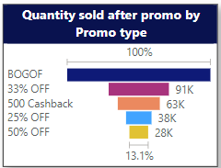

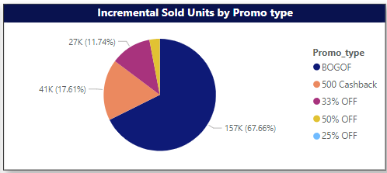
Promotion Type Analysis
Top 2 promotion types that yielded highest incremental revenue are
500 Cashback and BOGOF
Bottom 2 promotion types in terms of impact on Incremental sold units are
25% OFF and 50% OFF

Slide 12

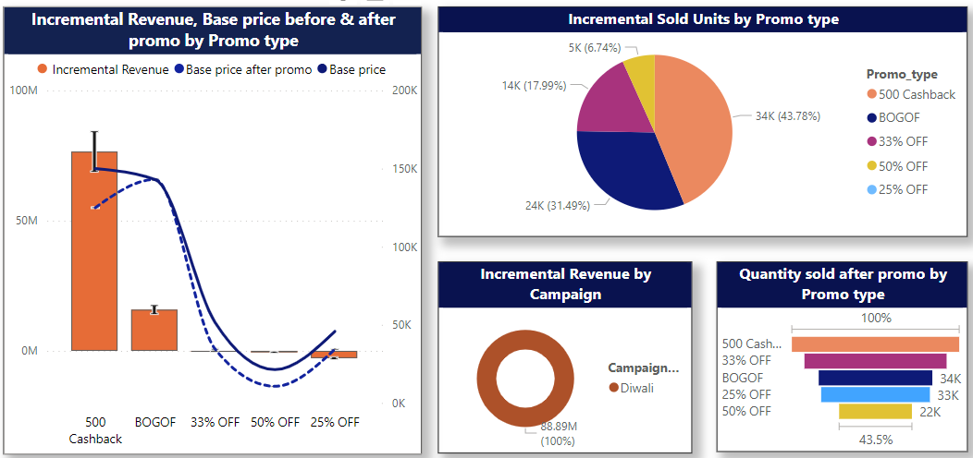

Promotion Type Analysis for Diwali Campaign
DIWALI CAMPAIGN
The analysis reveals that the "500 Cash Back" promotion performed exceptionally well in terms of generating incremental revenue and sold units during the Diwali campaign.

Slide 13

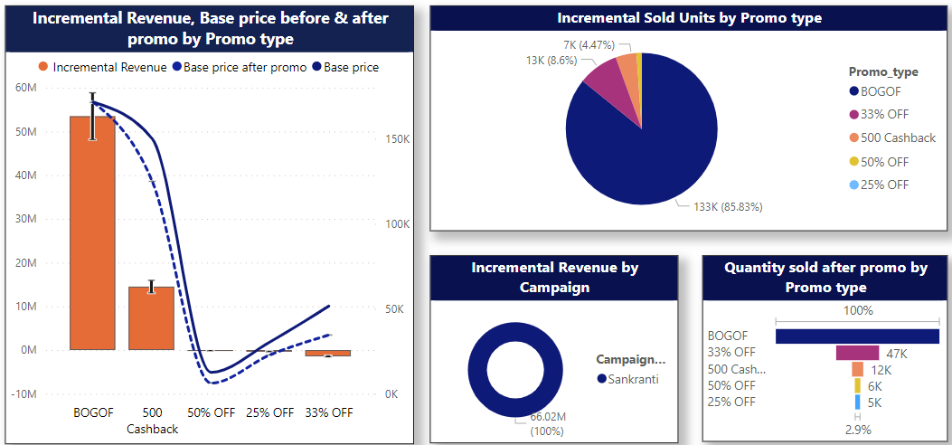

Promotion Type Analysis for Sankranti Campaign
SANKRANTI CAMPAIGN
Further, the analysis indicates that the "BOGOF" (Buy One, Get One Free) promotion emerged as a top performer in terms of generating incremental revenue and sold units during the Sankranti campaign.

Slide 14
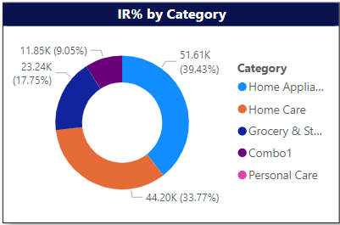
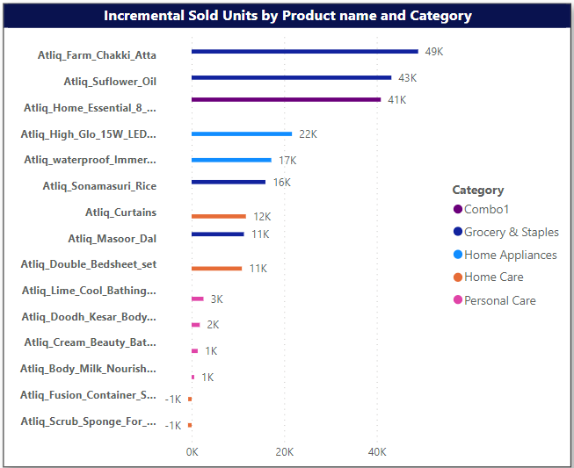

Product and Category Analysis
In general, categories such as Home Appliances, Home Care, and Groceries emerged as significant contributors to the incremental revenue percentage.

Slide 15
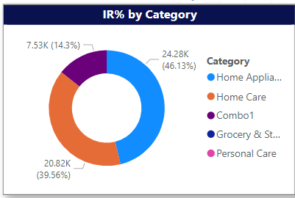
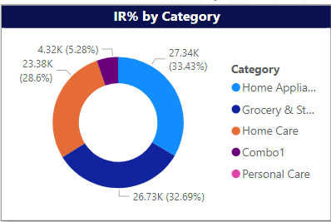
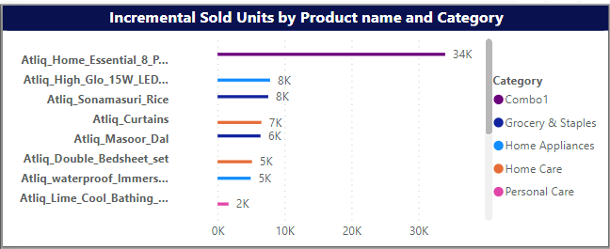
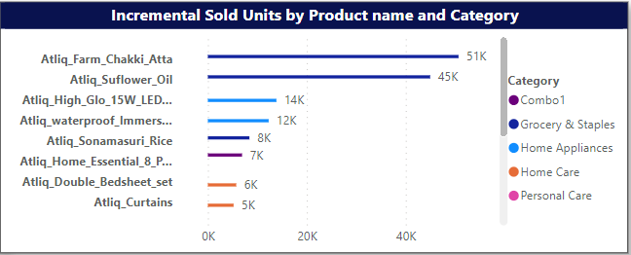
Product and Category Analysis for both campaigns
DIWALI
SANKRANTI
During Diwali campaign, product categories such as Home Appliances, Home Care and Combo resulted in higher incremental percentage(IR%) . Incremental sold units was higher for Combo category.
During the Sankranti campaign, higher incremental percentages (IR%) were observed in product categories like Home Appliances, Groceries, and Home Care. The Groceries category experienced a higher number of incremental sold units.

Slide 16
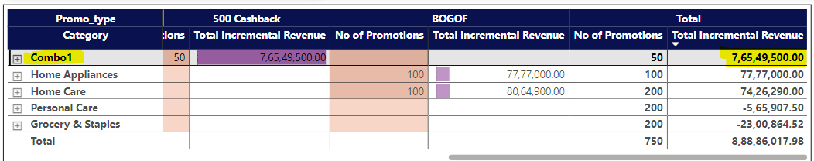
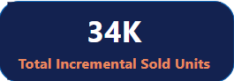
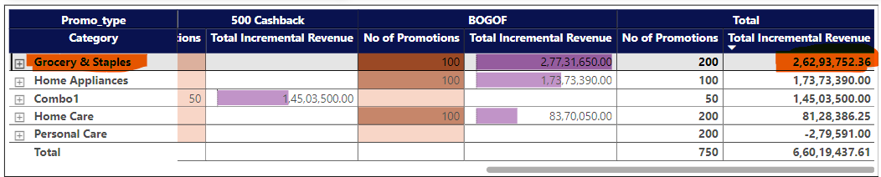
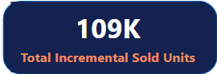
Diwali campaign (Combo product category) Vs. Sankranti campaign (Groceries & Staples)
DIWALI
SANKRANTI

Slide 17
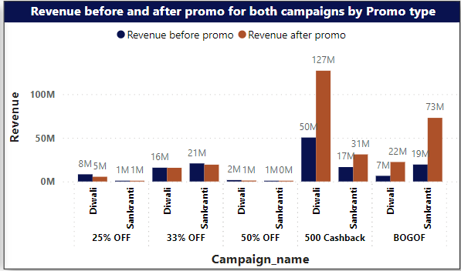
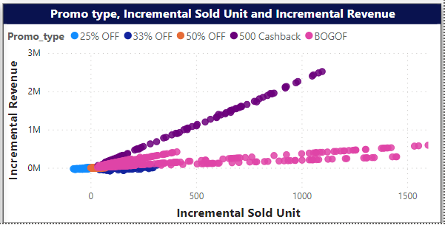
Insights
During the Diwali campaign, the 500 cashback promotional offer resulted in significant revenue. Conversely, during the Sankranti campaign, the BOGOF promotion demonstrated notable success.
In the case of the BOGOF promotion, it was observed that as the incremental units sold increased, the corresponding incremental revenue did not exhibit a proportional increase.
Instead, the relationship between incremental sold units and incremental revenue appeared to follow a linear trend with a lesser slope.
This suggests that while sales volume increased, the generated revenue did not rise at an equivalent rate, indicating potential factors, such as the type of product, promo-type influencing revenue generation beyond solely increasing sales volume.

Slide 18
Insights (cont..)
Although the product category remained the same (Combo) for both the Diwali and Sankranti campaigns in the case of the 500 cashback promotion, the total revenue yielded during the Diwali campaign was significantly higher compared to the Sankranti campaign.
This disparity may be attributed to the timing of the campaigns, as the Diwali campaign preceded the Sankranti campaign, allowing consumers to utilize the cashback promotion for purchasing combo sets during the Diwali campaign itself.
During the Sankranti campaign, there was a surge in purchases of groceries, home appliances, and home care products, resulting in increased quantity sold. However, this did not translate into significantly higher revenue, as these product categories typically do not yield substantial revenue.

Slide 19
Recommendations
Store Expansion Strategy: Implementing a store expansion strategy by adding number of stores in each city can significantly enhance revenue generation.
Streamlining Promotional Strategies: To optimize our campaign strategy and maximize revenue potential, we propose removing the 25% off, 33% off, and 50% off promotions for both campaigns. Our analysis demonstrates that these promotions have shown to be less effective compared to the Cashback and BOGOF promotions. By reallocating resources to focus on the more successful promotions, we aim to drive greater impact and ensure the highest possible return on investment.
Strategic Expansion of BOGOF Promotion: For the Diwali campaign, we propose extending the BOGOF (Buy One, Get One Free) promotion strategy to include groceries. This strategic adjustment aims to capitalize on the high demand for groceries during the festive period.
Introducing 500 Cashback Offer: During the Sankranti campaign, we propose introducing the 500 cashback promotional offer to a new set of product categories, apart from combo sets. Recognizing that customers may have already purchased combo sets during the Diwali campaign, this strategic adjustment aims to maintain consumer interest and incentivize purchases in different product categories.

Slide 20
Thank you

